Slide 1
Modelling
Society Energy Environment systems modelling
Mark Barrett
Mark.Barrett@ucl.ac.uk
UCL Energy Institute

Slide 2
Modelling: Contents
What are models for?
What is a model?
Modelling process
Examples and discussion

Slide 3
What are models for?
To understand and teach
  Building a model to reflect some aspects of reality
To identify future problems
  When will fossil reserves become scarce and expensive?
To develop policies
  How do we reduce carbon emissions at least cost?
For political argument
  Who is funding and doing the modelling?
  What are their objectives?
  How does the funder’s agenda affect:
    what is included in and excluded from the model?
    the exogenous inputs to the model?
    the model outputs and their presentation?

Slide 4
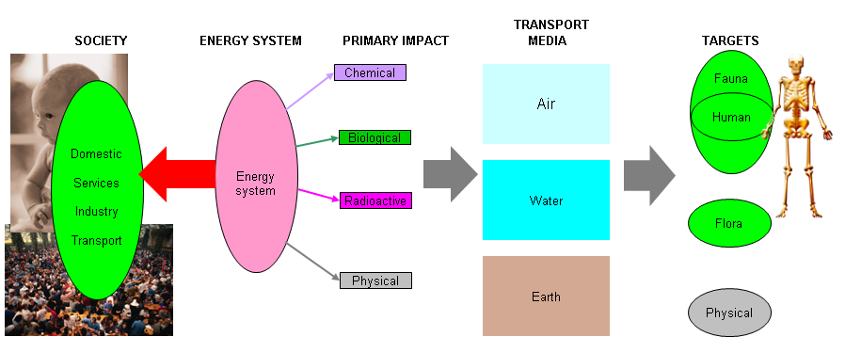
The society, energy, environment system
People in society have energy service demands that are met by energy systems which cause primary inputs to the environment. These inputs are modified and transported via media to impact on biota.

Slide 5
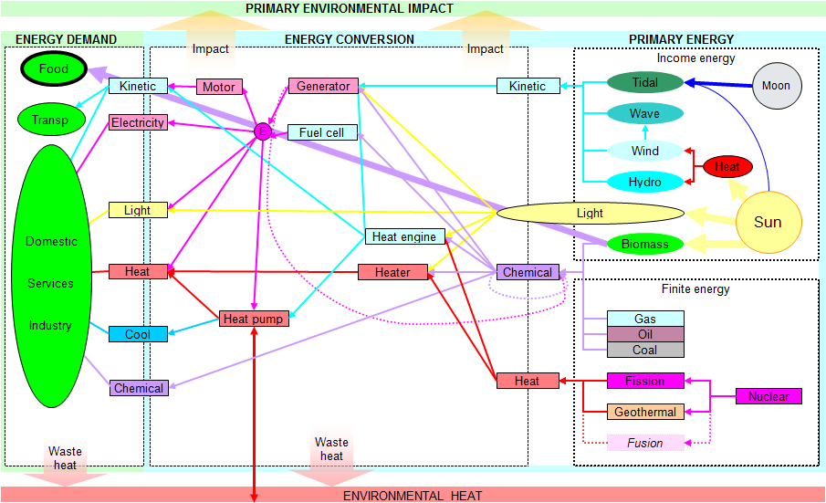
The energy system: demand and supply options
Energy demands and sources can be linked in many ways. The appropriate linkage depends on a complex of their distribution in space and time, and the economics of the technologies used.

Slide 6
What is a model?
Must at least include a mathematical representation of a physical system (social and/or technological) bounded in space and time
  Past state and Internal relationships based on historical data
  Exogenous data inputs:
    Initial system state based on historical data
    Future values from system environment
Domains of model
  Physical variables only
  Behavioural: social, economic
Some types and methods of modelling
  Dynamic and static
  Simulation: with differential equations
  Statistical: Monte Carlo
  Optimisation: linear /non linear programming, genetic algorithms, etc.
Models are a form of human knowledge, and are incomplete and inaccurate, as any other form of knowledge about the physical world.

Slide 7
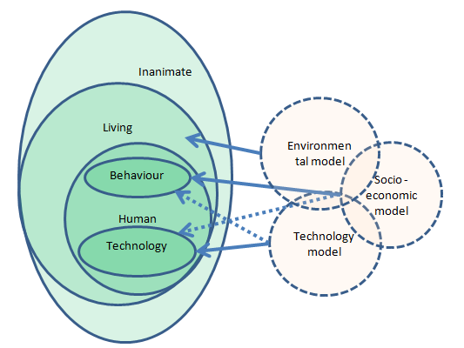
The society, energy environment system and models

Slide 8
The modelling process
What is the question? What is the curiosity?
Collation of information about the world
  Processes – how do things work?
  Historical state of the system being modelled and exogenous factors
Build a model
  Structure data
  What software and hardware environment will be used?
  Write programme to
    input data
    emulate processes, simulate, optimise
    output data
Validate the model
  Does the model reflect reality as described by historical data?
Practicalities
  Money?
  Who will build model?
  Who will run it?

Slide 9
Model and data implementation
Model
Any Turing machine will do!
Any programmable system: Excel/VBA, FORTRAN, Matlab, Python, C…….
Some higher level packages built on programming language: GAMS, optimizers, simulators
To run in environments: Windows, Mac, Unix….
Models previously developed: EnergyPlus, TAS, MARKAL…
Choice depends on:
Questions, needs
Users’ and developers’ knowledge
Software and systems of users
Special requirements; speed, packages, graphics etc.
Data
Most computer languages have routines to read and write to databases
Small dbs: Excel etc.
Large dbs: Access, SQL

Slide 10
The energy service chain
SERVICE CHAIN
Energy required to make and operate service delivery system.
Services and supplies have spatiotemporal distributions (some weather dependent)
Storage improves security
A given energy system has a configuration of these principal components:
Demands (D): heating, lighting, transport, etc.
Converters (C): convert energy in one form and place to another
Artificial stores (A): heat, work
Natural stores (N): heat, work
And it operates in an environment
Environment (V)

Slide 11
Data: endogenous
Essential to have historical data on:
the flows through the system and its state
the stocks and features of the SEE system at some historical point
how the environment, people and technologies behave
These data are used to:
assess the accuracy of a model (it has to at least emulate the past)
provide a base line or starting point for modifying the system
Collating and updating databases is hard. Most data at least 3 years old.
Flows and state
Energy – flows and storage of different forms at different points in the system
Emission
Money
Stocks: Numbers and types of
people
technologies
Behaviour
How system components behave according to physical and social factors

Slide 12
Data: exogenous
All models address a restricted part of the world in terms of:
system components and processes
space
time
Elements of the world that affect the system modelled, but are not included in the model, need to be accounted for, these require exogenous assumptions.
These assumptions may be based on extrapolations of historical data by judgement, or other models, for example:
Dwelling model: tenants, behaviour
City model: city population, commuting, commercial activities
Electricity model: fuel prices and availability, import potential
National forecasting model: population, international fuel prices, energy trade

Slide 13

DYNAMICS – WHAT AND WHY
Long term dynamics – changes to capital stocks (buildings, power stations, etc.) in scenarios transforming whole energy system
Short term dynamics - demand-supply matching over minutes to months
1 and 2 required for optimisation of system design.
2 required:
to ensure system is technically feasible e.g. mix of renewables and dispatchable generators works;
to explore potential of fast measures such as load management and spatiotemporal controls in buildings
to do accurate costing and estimation of emissions, environment and health impacts, etc.

Slide 14
Time dynamics: years
SEE systems evolve over the years in terms of stocks of components and configuration.
  Demography: People, households
  Technologies: dwellings, cars, power stations
The rate at which systems can change depends largely on the rates of additions and subtractions from stocks
The rate of stock change is a strong determinant of how fast policies can take effect
S(t+1) = S(t) + A(t) – S(t)
    Subtractions depend on assumed lifetime and age structure of stock. A unit may be subtracted deterministically (after a fixed number of years) or according to a probability distribution (e.g. for people dying).
    Additions depend on change in total stock requirements and subtractions.
These stock elements (people, technologies) have ‘typical’ historic lifetimes, but these may be changed through policies. For example, old polluting cars or power stations might be phased out quickly with tax or subsidy.

Slide 15
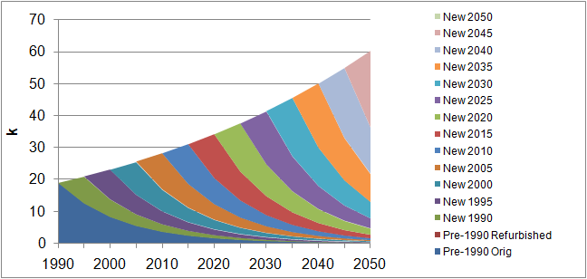
Stock dynamics; years - examples
People Ships
Dwellings Appliances

Slide 16
Stock dynamics and scrappage - cars

Slide 17
Time dynamics: operation
Given a configured system of stocks, the simulation model then generally calculates energy flows between system components over some time step (minutes, hours, days)
In general the operation of components is a complex function of many factors.
D(t) = f(people, time, environment, technology)
Energy in = Energy out / Converter efficiency
Ein(t) = Eout(t) / Ceff(t)
where converter efficiency is a variable function
Ceff(t) = f(environment, load, etc.)
Artificial storage level = previous level + energy out – energy out
A(t+1) = A(t) + Ein(t) - Eout(t)
Natural storage level = previous level + energy out – energy out
N(t+1) = N(t) - Eout(t)

Slide 18

Building dynamics
Wait for animation to run
Weather and
Occupancy, over hours and months, drive:
ventilation
energy flows
pollution
personal exposure

Slide 19
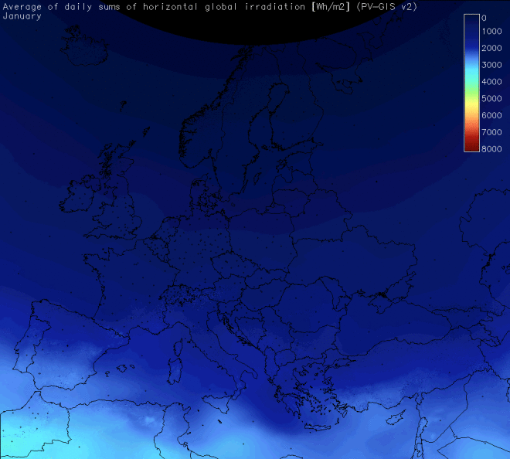
The Physical Environment
http://sunbird.jrc.it/pvgis/pv/animations/images/global_anim66.gif

Slide 20
Hourly weather : March

Slide 21
Hourly weather: August

Slide 22
Hourly weather : January

Slide 23
Milton Keynes Linford house hourly heat loads

Slide 24
Daily weather and fuel consumption: wks 1/2
Data for Milton Keynes 5 bed 4 occupant house provided by Alex Summerfield

Slide 25
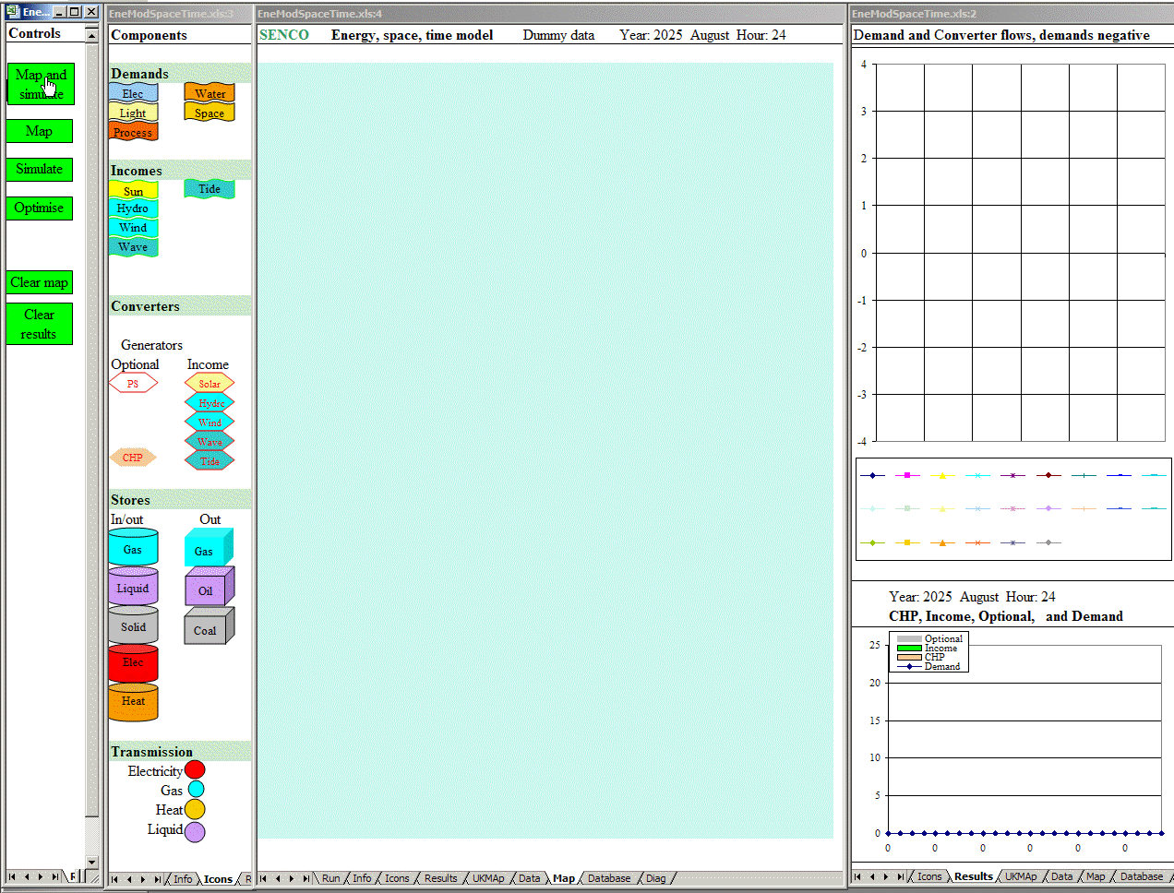
UK energy, space and time : animated

Slide 26

VarInt : Day sampling : animation

Slide 27
UK Energy flow chart: 1990

Slide 28
UK Energy flow chart: Animation 1990 to 2050

Slide 29
Scenario context: UK Energy flow chart: 2050

Slide 30
Objectives, instruments and measures

Slide 31
Ethics: equal CO2 emission per person?
Humans have equal rights to emissions, therefore convergence of emission per person in the EU and elsewhere? What about different resources and climate of countries? Note that for global equity, EU per capita emissions will have to fall by over 95% to reach 60% reduction globally.

Slide 32
OBJECTIVES OF STRATEGY
SOCIAL, ECONOMIC, POLITICAL
Meet objectives at least cost with social equity
Avoid irreversible, risky technologies
ENERGY SECURITY
Reduce dependence on finite fossil and nuclear fuels
UK 20% of energy from renewables by 2020 => ~35% renewable electricity?
renewable transport fuels: 5% of by 2010, 10% by 2020
ENVIRONMENT
UK
Government targets for GHG reduction from 1990: 12-20% by 2010, ~30% by 2020, 60-80% 1990-2050, including international transport.
Require >95% GHG reduction for climate control and global equity
Europe
20/30% GHG reduction 1990-2020

Slide 33
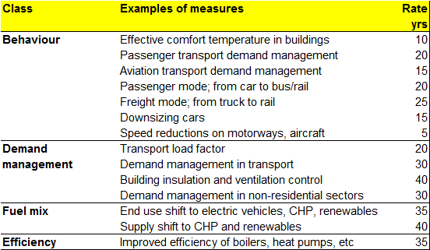
Policy measures: physical measures and rate of change
Size of effect, rate of effect and cost

Slide 34
Auto-Oil programmes: objectives and scope
Objectives
To develop strategy to meet air quality standards across EU at least cost
Focus on air quality standards in 2010, but period to 2020 to be considered
Strategy least cost, but also practicable in wider economic, social and political terms
Strategy consistent with other environmental objectives
Scope
Pollutants - NOx, CO, VOCs, PM, benzene, ozone, (SO2, CO2)
All 15 EU countries
Pollution emission from transport and stationary sectors to be considered
All emission control instruments and measures for transport to be considered

Slide 35
Auto-Oil I - Structure

Slide 36
Possible objectives, constraints and implications
A. Minimise the Present Value of abatement costs so as to meet physical environmental targets
(Objective used in Auto-Oil programmes 1 and 2)
Ensures environmental targets will be met
Gives no value to overshoot of targets
Does not require impact weighting
B. Minimise Discounted Cost/Impact ratio (whilst meeting physical environmental targets?)
Ensures environmental targets will be met
Gives more weight to short term impact reduction
Requires impact weighting
C. Minimise the Net Present Value of costs due to damage and those due to abatement
This is a CBA and requires an assessment of the benefits of reducing environmental impacts
Requires a full analysis of the social costs of pollution
Will give more weight to short term costs
Does not guarantee that physical environmental targets will be met, may lead to over or under ‘achievement’
Does not require impact weighting

Slide 37
Analytic schema : physical process and costs

Slide 38
Outdoor pollution concentration
Outdoor pollution concentrations vary spatiotemporally, and so affect exposure and indoor concentrations.
Graphs illustrate emissions and concentrations at different times across a city cross-section.
3 am 6 pm

Slide 39
Technical basis: SEEScen: Society, Energy, Environment Scenario model
SEEScen is applicable to any large country having IEA energy statistics
SEEScen calculates energy flows in the demand and supply sectors, and the microeconomic costs of demand management and energy conversion technologies and fuels
SEEScen is a national energy model that does not address detailed issues in any demand or supply sector.
Method
Simulates system over years, or hours given assumptions about the four classes of policy option
Optimisation under development

Slide 40
AN OVERALL DATA AND MODELLING SCHEMA

Slide 41
Stock model
Purpose: calculate energy, carbon, costs (+health) of population in built stocks for scenarios
Inputs:
Demography and use patterns
Building stocks, appliances
Energy efficiency and supply programmes
Outputs:
Energy (annual, hourly)
Costs
(Labour, material requirements…)
Methods
Simulation of individual occupant/building combinations and changing populations
Optimisation?

Slide 42
Stock model - parameters
What combinations of social, building and weather parameters to model with individual building and stock models? Depends on questions! Number of possible combinations is astronomic.
Social:
Household type, activity, appliances, wealth, ownership/tenure…
Building:
Built form and size
Fabric and ventilation including efficiency measures
Energy systems and controls
Weather:
Historic and projected weather and pollution datasets (location, years?)

Slide 43
UK dwellings scenario illustration: database 1
Efficiency packages taken from individual building optimization?
Summary characteristics of building:
Areas envelope, % external
U-values
Cost of elements

Slide 44
UK dwellings scenario : database 2
Other characteristics of building:
Specific loss
Space heat load
Other demands
Embedded energy and carbon
Capital costs

Slide 45
UK dwellings scenario (illustration)
Slow demolition rate, so refurbish.
Stock projection
Cohort space heat loss
Space heat in 2050 dominated by current buildings

Slide 46
Transport : system, instruments and measures

Slide 47
Overview
Notes:
2

Slide 48
Local impacts
Notes:
12

Slide 49
AviAn – aircraft model
Aircraft technically much more complex in terms of energy consumption and altitude effects

Slide 50
Switch to optimisation

Slide 51
Modelling work
Look at spreadsheet model
Google other models
Questions:
  What questions/objectives are being addressed?
  Who is modelling?
  Which system is being studied?
  What are its boundaries?
  What sort of model is it?
  What are exogenous assumptions?
  Which techniques are used?
  How is the model validated?
  How might its results change?

